Slide 1


A Reinforcement Learning Framework for Eliciting High Quality Information
Zehong Hu, Yang Liu, Yitao Liang, Jie Zhang
December 8, 2017

Slide 2

Background: Crowdsourcing
Use Peer Prediction to verify contributions
Assumptions
(1) an explicitly known worker models
(2) workers act rationally

Slide 3

Dynamically adjust incentives to encourage workers to exert high efforts even if they may not be rational

Slide 4
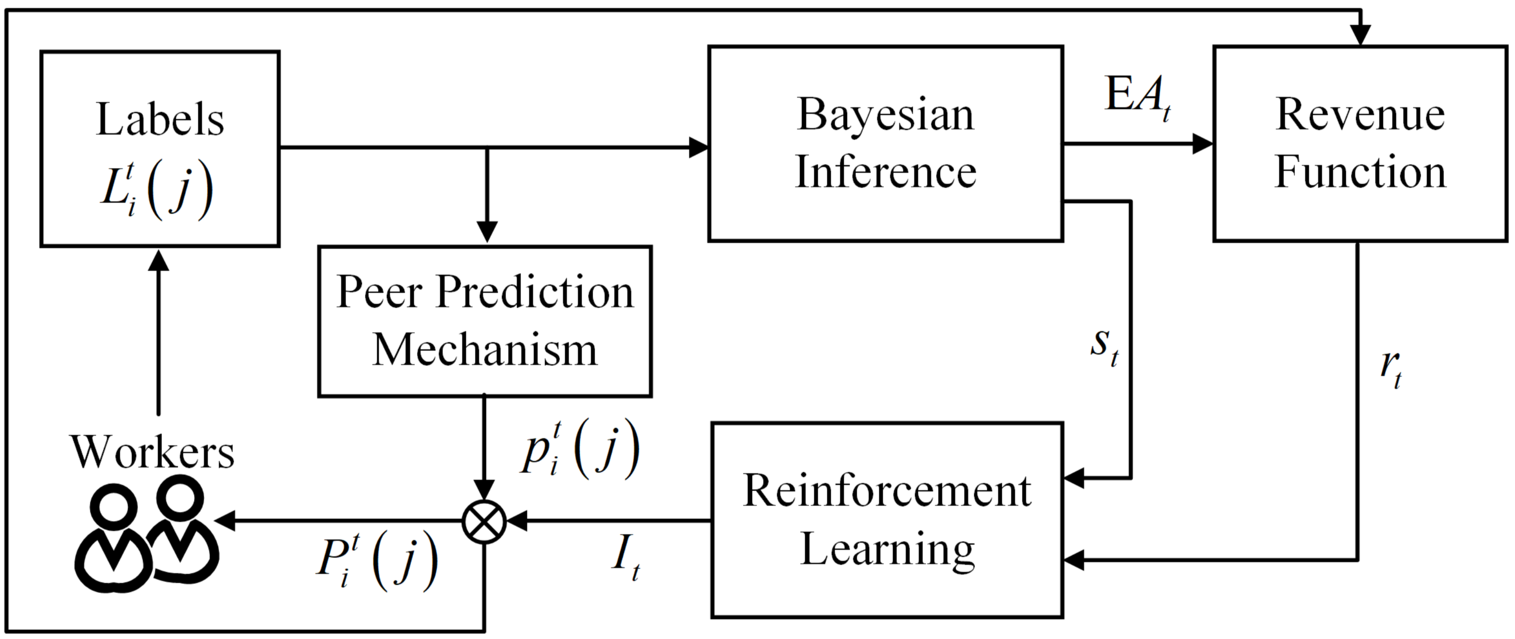
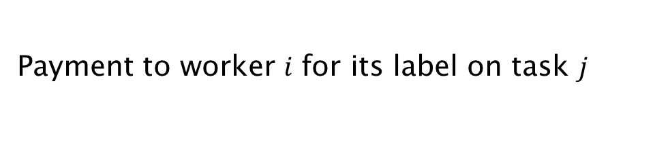
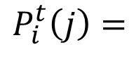

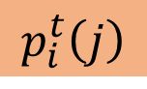

Reinforcement Peer Prediction
Payment to worker $i$ for its label on task $j$
The scoring function which ensures the incentive compatibility.
$$P_{i}^{t}\left(j\right)=$$
$$I_{t}$$
$$×$$
$$p_{i}^{t}\left(j\right)$$
The incentive level which is adjusted by our reinforcement algorithm.
Effectively consider the multi-agent setting between the data requester and workers

Slide 5
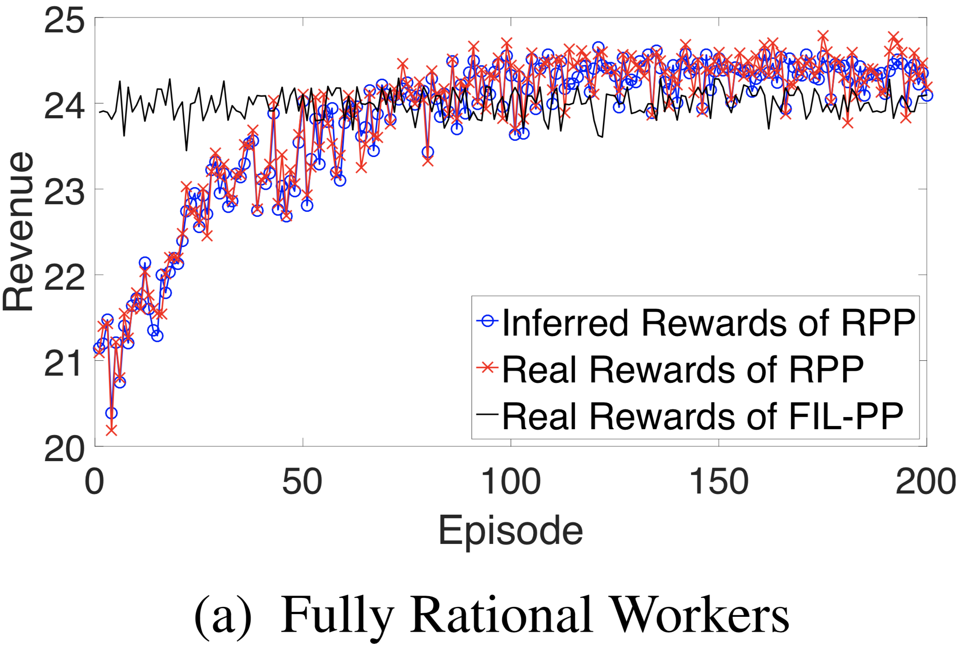
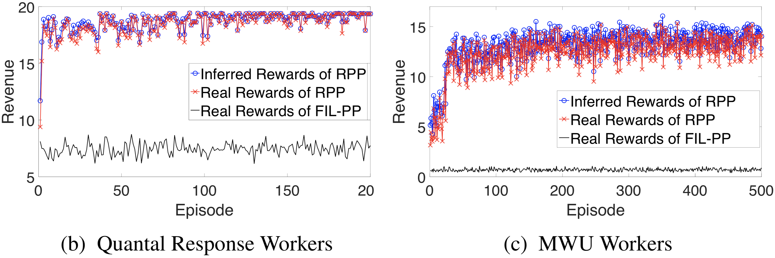


Results under 3 Different Worker Models
Significant Improvement

Slide 6

Thanks
https://github.com/vascohu/RLPeerPrediction

